Slide 1
Macroeconomic nowcasting
Frank P. Pijpers
06/10/2026

Slide 2
Factors as model building blocks
Factor models are useful tools independent of nowcasting
The use of factor models for parsimonious nowcasting

Slide 3
Data ≠ Information
Recent decades : an explosion in available socio-economic time series, many with very high cadence.
Problem 1: long time series with uniform quality are less common. How to capture very long term cycles?
Problem 2: often, the data are measurements of very nearly the same underlying process. How to count/measure how much each new series contributes in new independent information?

Slide 4
some ‘idiom’
idiosyncratic shocks noise
(dynamic) factors (principal) components
(trend & cycle) & seasonal & irregular
low frequency & mid-frequency & high frequency

Slide 5
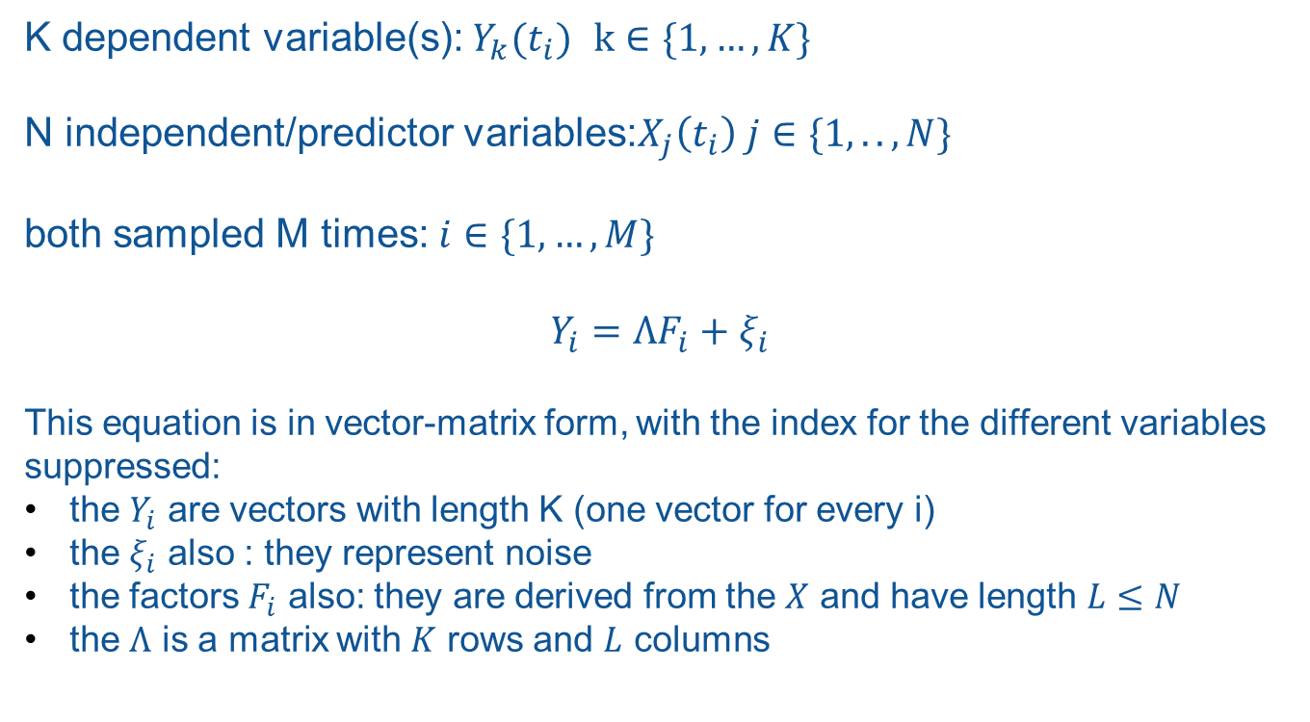
Equations (definitions)
K dependent variable(s): $Y_{k}(t_{i})$ $k∈\{1,…,K\}$
N independent/predictor variables:$X_{j}\left(t_{i}\right) j∈\{1,..,N\}$
both sampled M times: $i∈\{1,…,M\}$
$$Y_{i}=ΛF_{i}+ξ_{i}$$
This equation is in vector-matrix form, with the index for the different variables suppressed:
the $Y_{i}$ are vectors with length K (one vector for every i)
the $ξ_{i}$ also : they represent noise
the factors $F_{i}$ also: they are derived from the $X$ and have length $L≤N$
the $Λ$ is a matrix with $K$ rows and $L$ columns

Slide 6
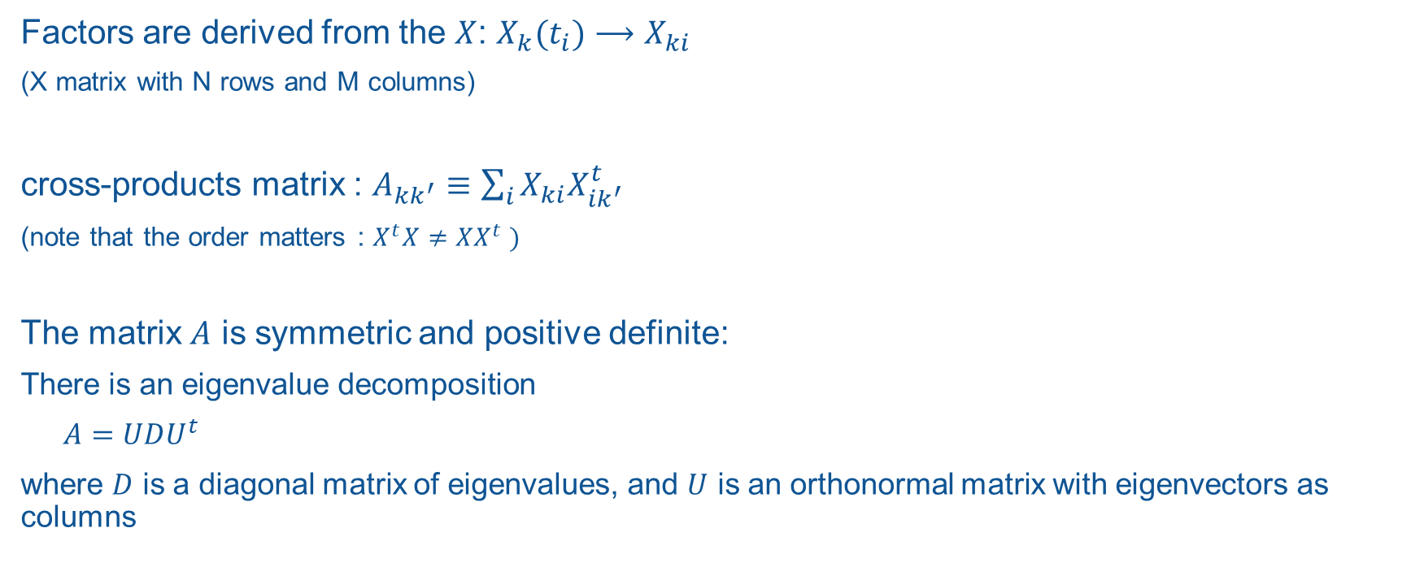
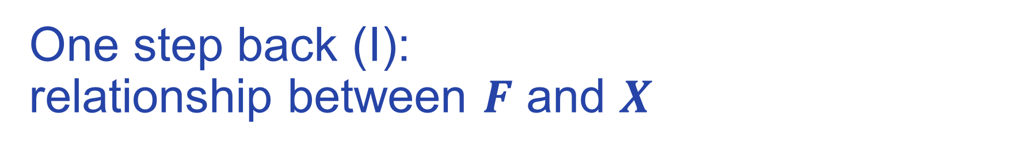
One step back (I): relationship between $F$ and $X$
Factors are derived from the $X$: $X_{k}(t_{i})⟶X_{ki}$
(X matrix with N rows and M columns)
cross-products matrix : $A_{kk^{′}}≡\sum_{i}{X_{ki}X_{ik^{′}}^{t}}$
(note that the order matters : $X^{t}X≠XX^{t} )$
The matrix $A$ is symmetric and positive definite:
There is an eigenvalue decomposition
$A=UDU^{t}$
where $D$ is a diagonal matrix of eigenvalues, and $U$ is an orthonormal matrix with eigenvectors as columns

Slide 7
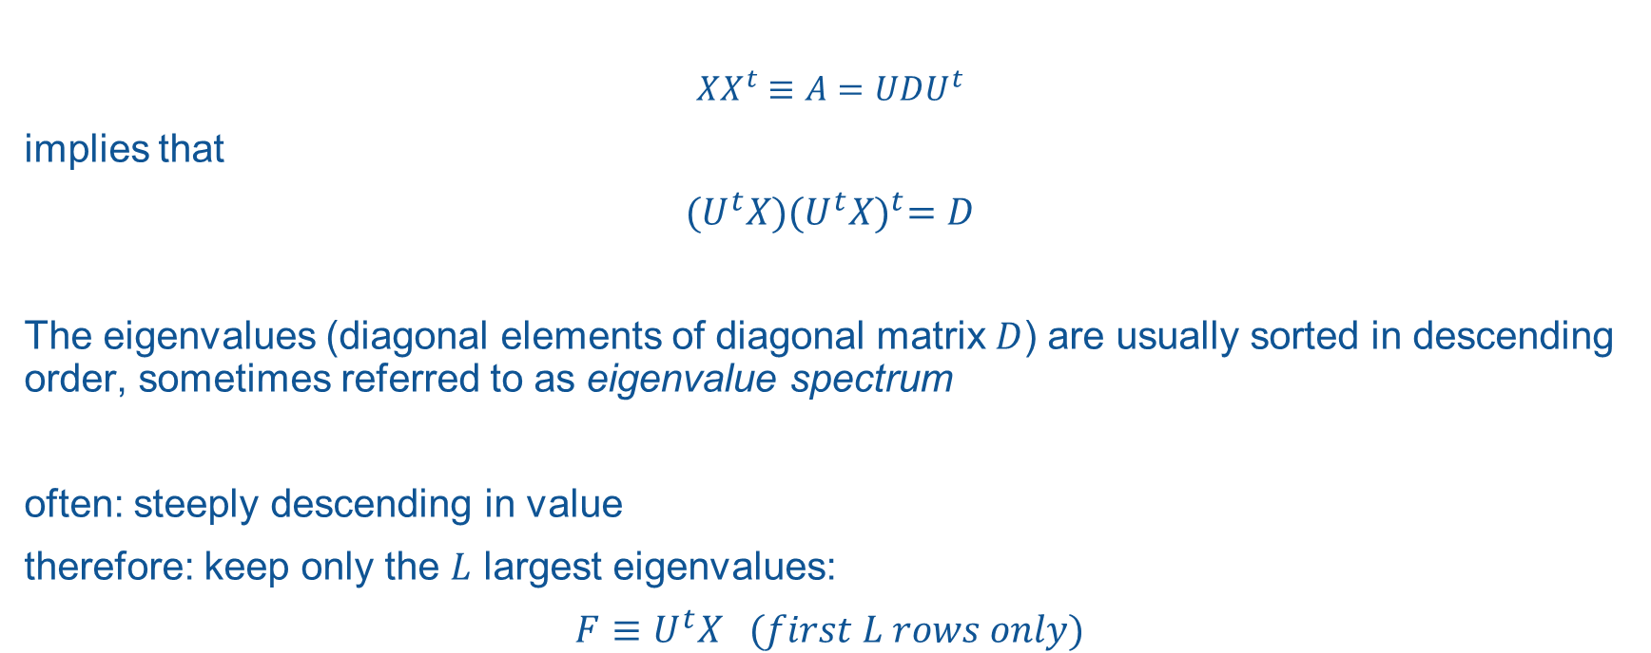
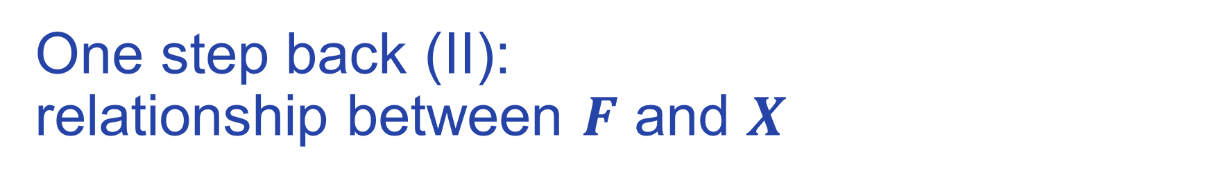
One step back (II): relationship between $F$ and $X$
$$XX^{t}≡A=UDU^{t}$$
implies that
$${(U}^{t}X){(U^{t}X)}^{t}=D$$
The eigenvalues (diagonal elements of diagonal matrix $D$) are usually sorted in descending order, sometimes referred to as eigenvalue spectrum
often: steeply descending in value
therefore: keep only the $L$ largest eigenvalues:
$$F≡U^{t}X (first L rows only)$$

Slide 8
Why would this make sense ?

Slide 9
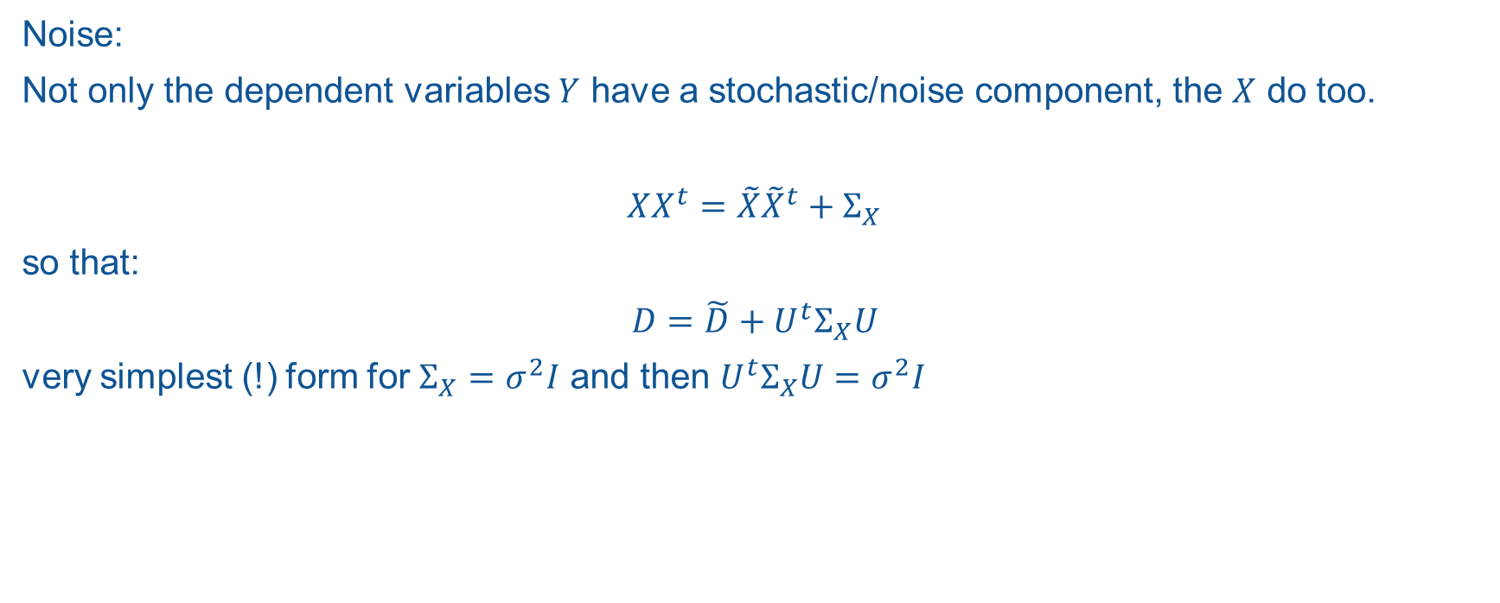
Why would this make sense ?
Noise:
Not only the dependent variables $Y$ have a stochastic/noise component, the $X$ do too.
$$XX^{t}=\tilde{X}{\tilde{X}}^{t}+Σ_{X}$$
so that:
$$D=\tilde{D}+U^{t}Σ_{X}U$$
very simplest (!) form for $Σ_{X}=σ^{2}I$ and then $U^{t}Σ_{X}U=σ^{2}I$

Slide 10
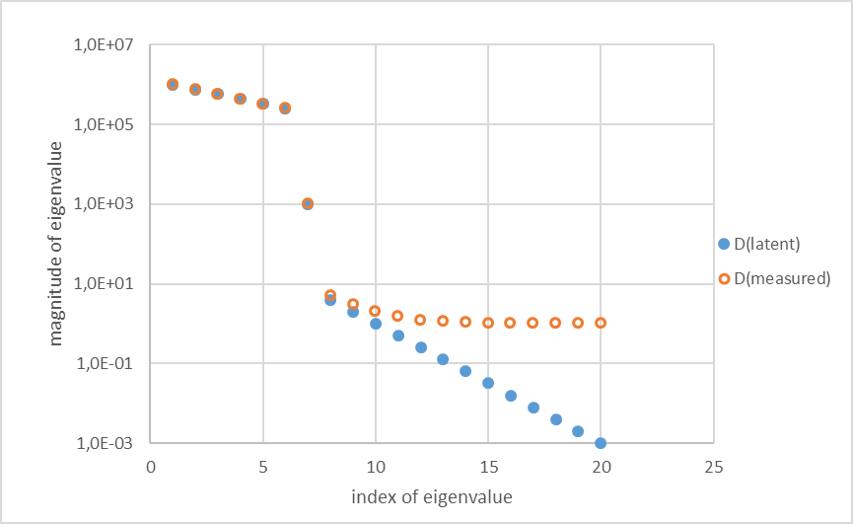
idealised artificial example

Slide 11
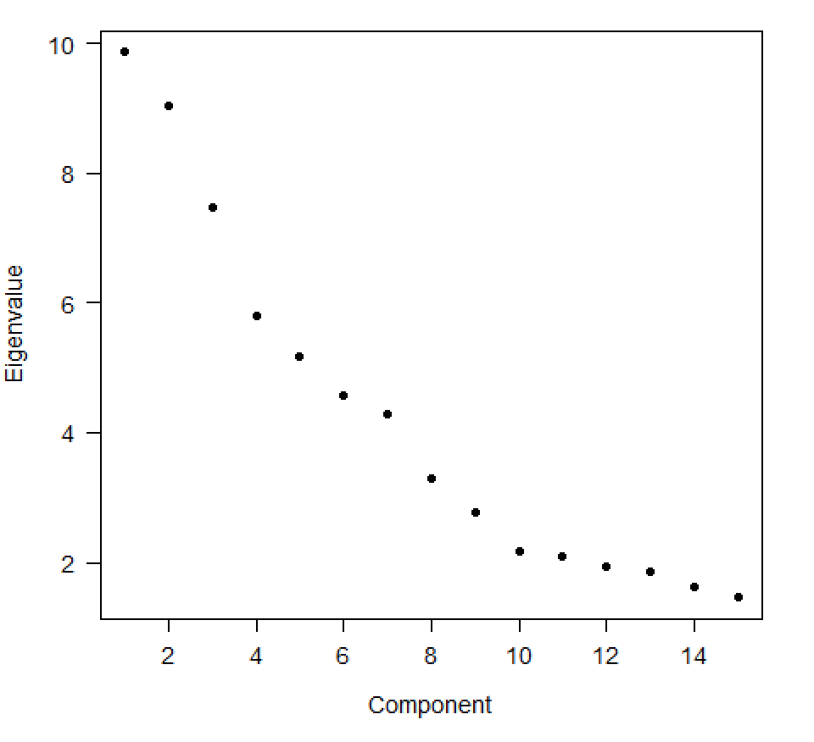
Data set of 88 auxiliary time series for NL

Slide 12
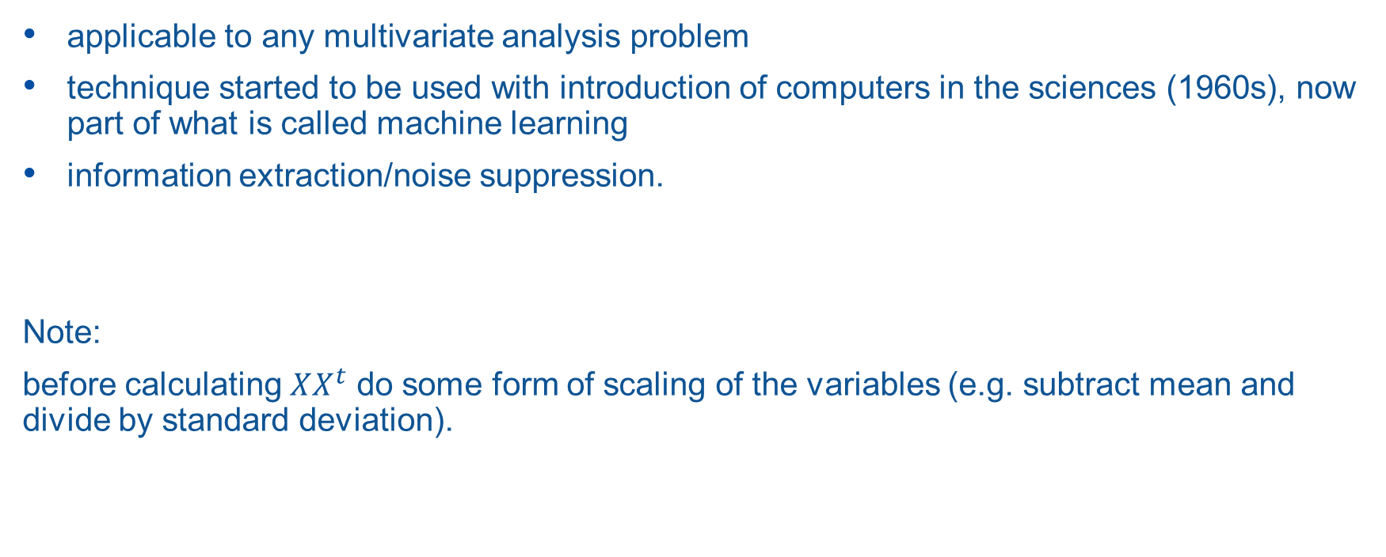
not limited to time series
applicable to any multivariate analysis problem
technique started to be used with introduction of computers in the sciences (1960s), now part of what is called machine learning
information extraction/noise suppression.
Note:
before calculating $XX^{t}$ do some form of scaling of the variables (e.g. subtract mean and divide by standard deviation).

Slide 13
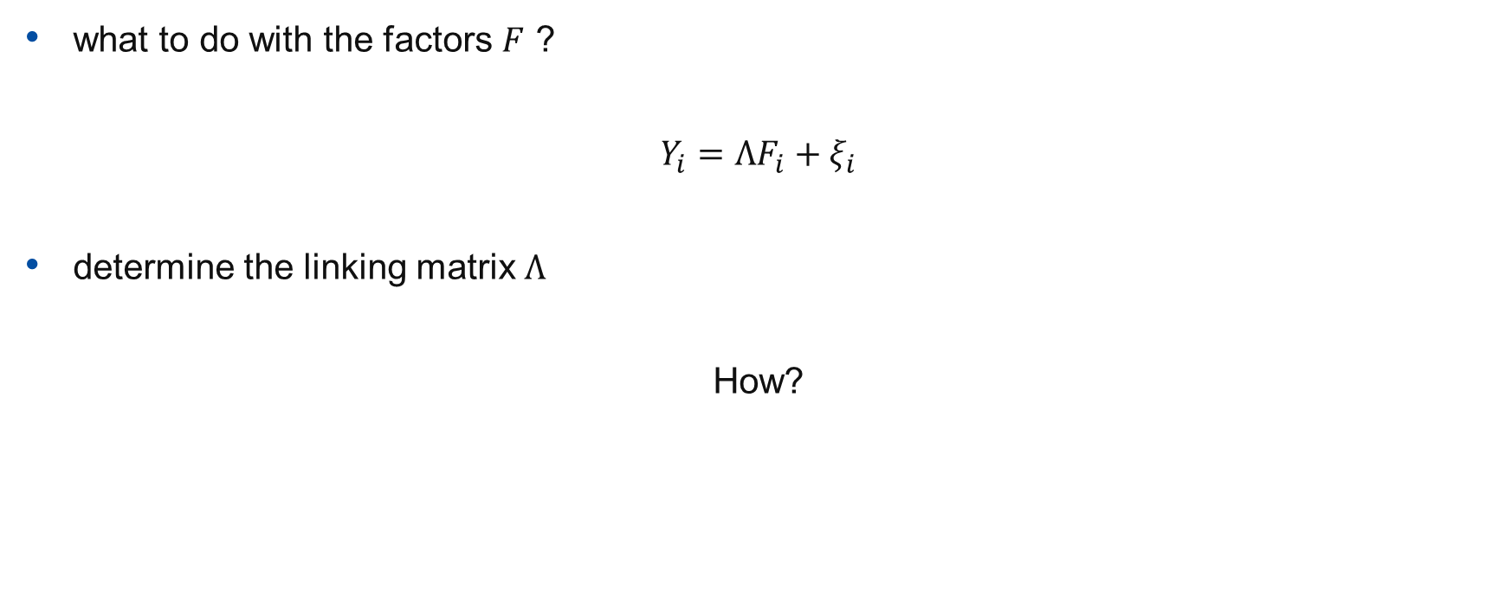
Go forward again (I)
what to do with the factors $F$ ?
$$Y_{i}=ΛF_{i}+ξ_{i}$$
determine the linking matrix $Λ$
How?

Slide 14
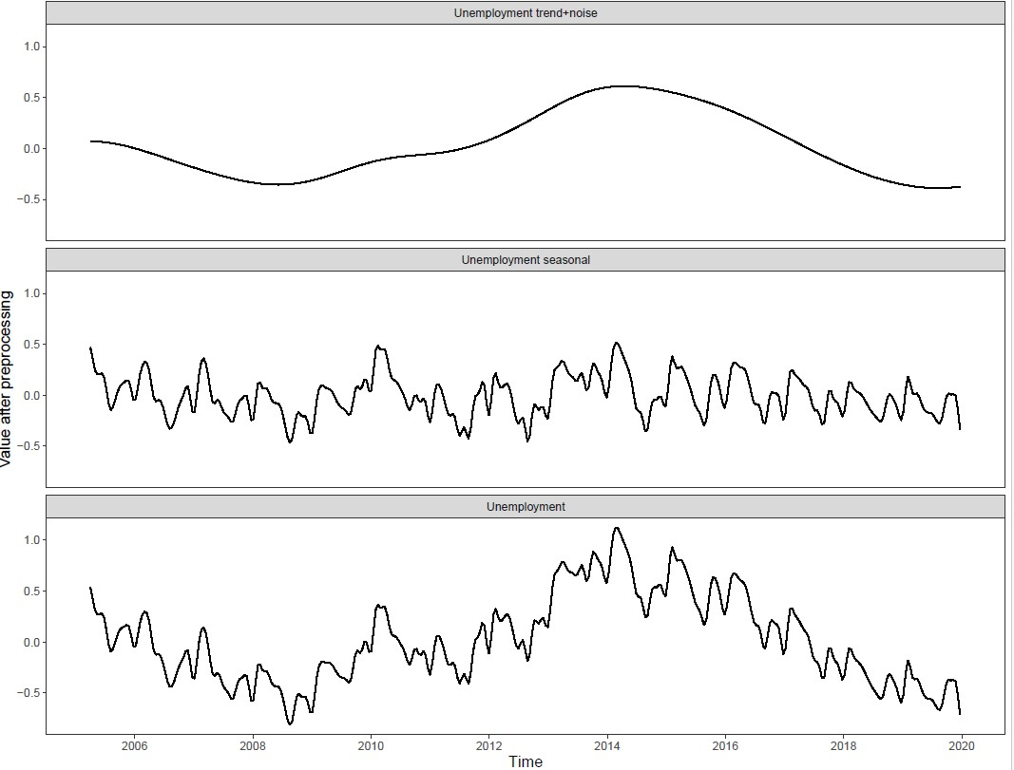

Slide 15
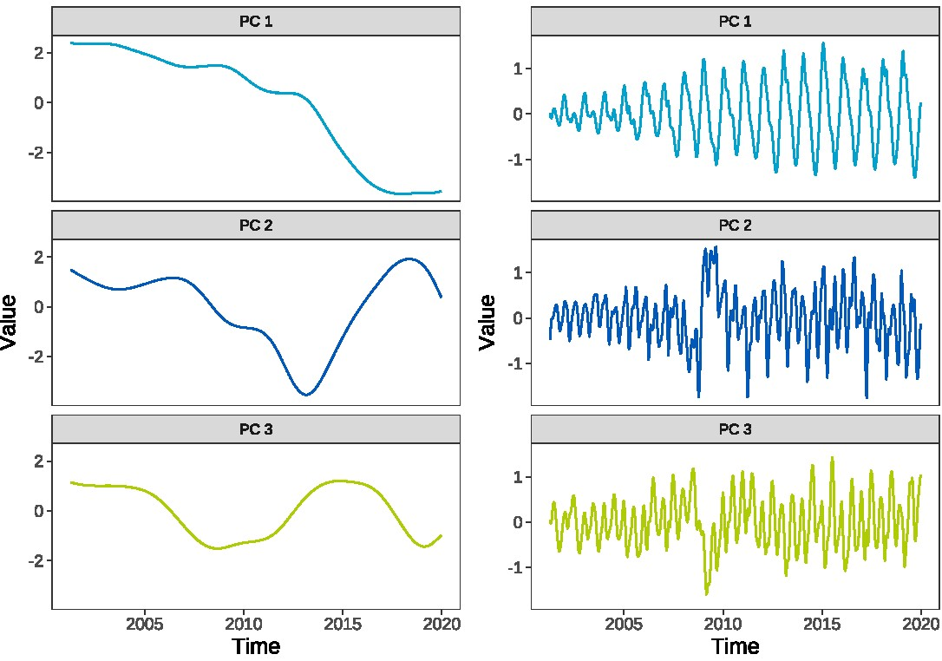

Slide 16
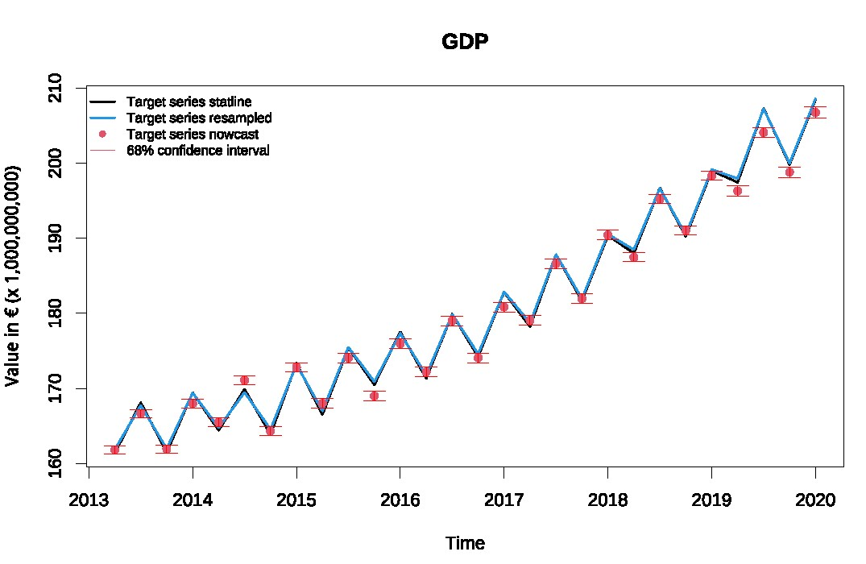

Slide 17
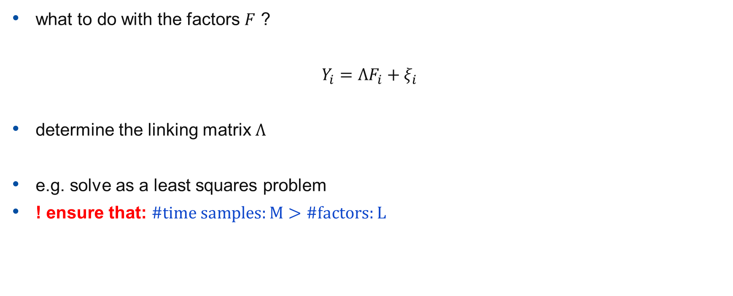
Go forward again (II)
what to do with the factors $F$ ?
$$Y_{i}=ΛF_{i}+ξ_{i}$$
determine the linking matrix $Λ$
e.g. solve as a least squares problem
! ensure that: $\#time samples:M>\#factors:L$

Slide 18
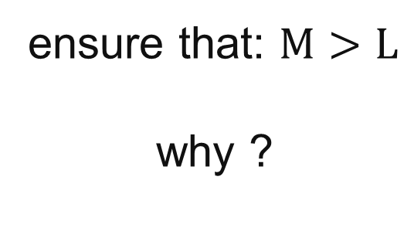
ensure that: $M>L$
why ?

Slide 19
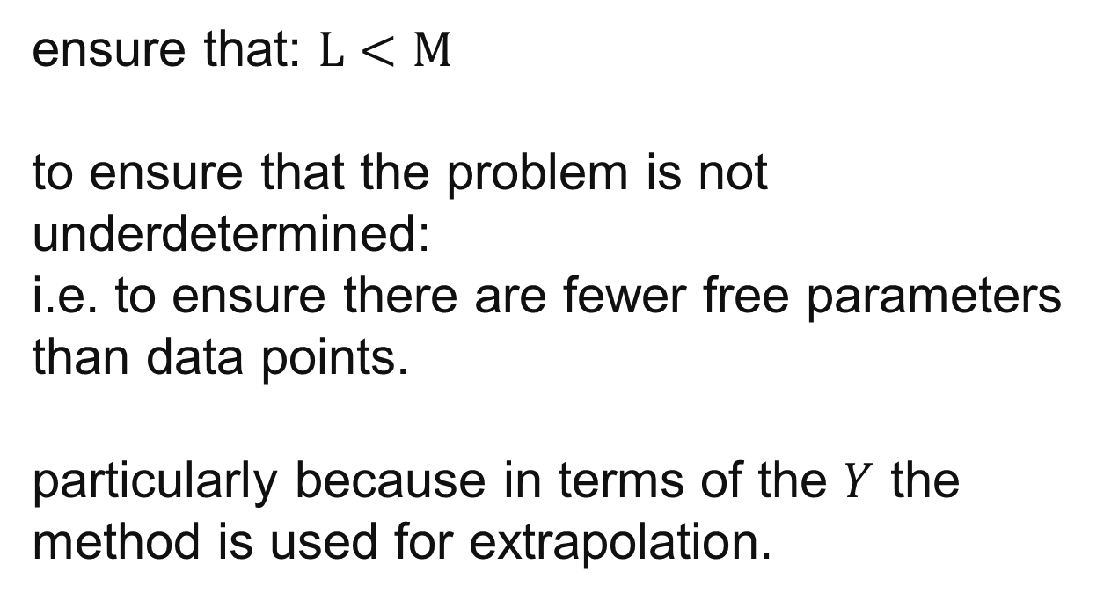
ensure that: $L<M$
to ensure that the problem is not underdetermined:
i.e. to ensure there are fewer free parameters than data points.
particularly because in terms of the $Y$ the method is used for extrapolation.

Slide 20
Factor models, part 2

Slide 21
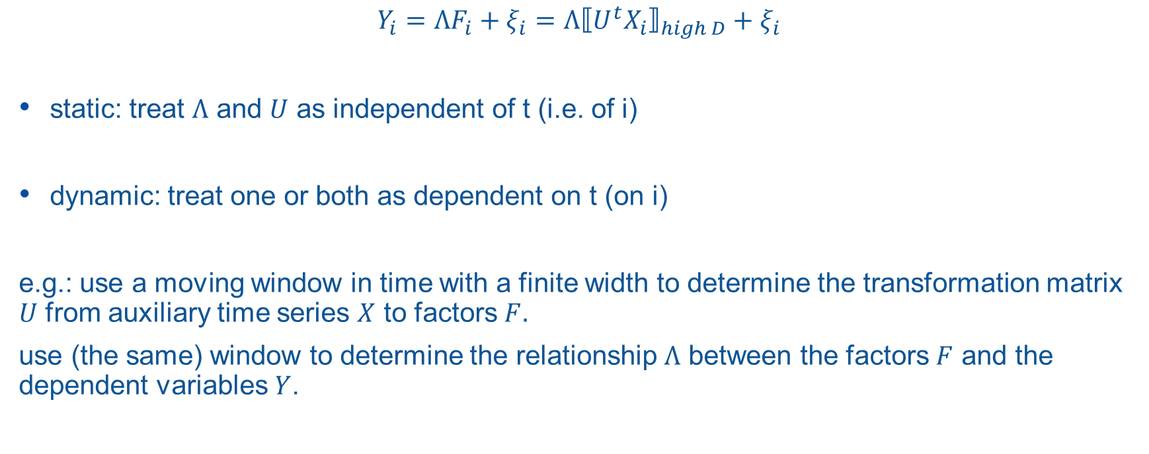
Static or dynamic factors?
$$Y_{i}=ΛF_{i}+ξ_{i}=Λ{⟦{U^{t}X}_{i}⟧}_{high D}+ξ_{i}$$
static: treat $Λ$ and $U$ as independent of t (i.e. of i)
dynamic: treat one or both as dependent on t (on i)
e.g.: use a moving window in time with a finite width to determine the transformation matrix $U$ from auxiliary time series $X$ to factors $F.$
use (the same) window to determine the relationship $Λ$ between the factors $F$ and the dependent variables $Y$.

Slide 22
choosing a window
if we limit to a finite time window, remember that length of window M must remain greater than number of factors L.
choices:
  uniform weights
  (exponentially) decreasing going back
  time/frequency filtering
  …

Slide 23
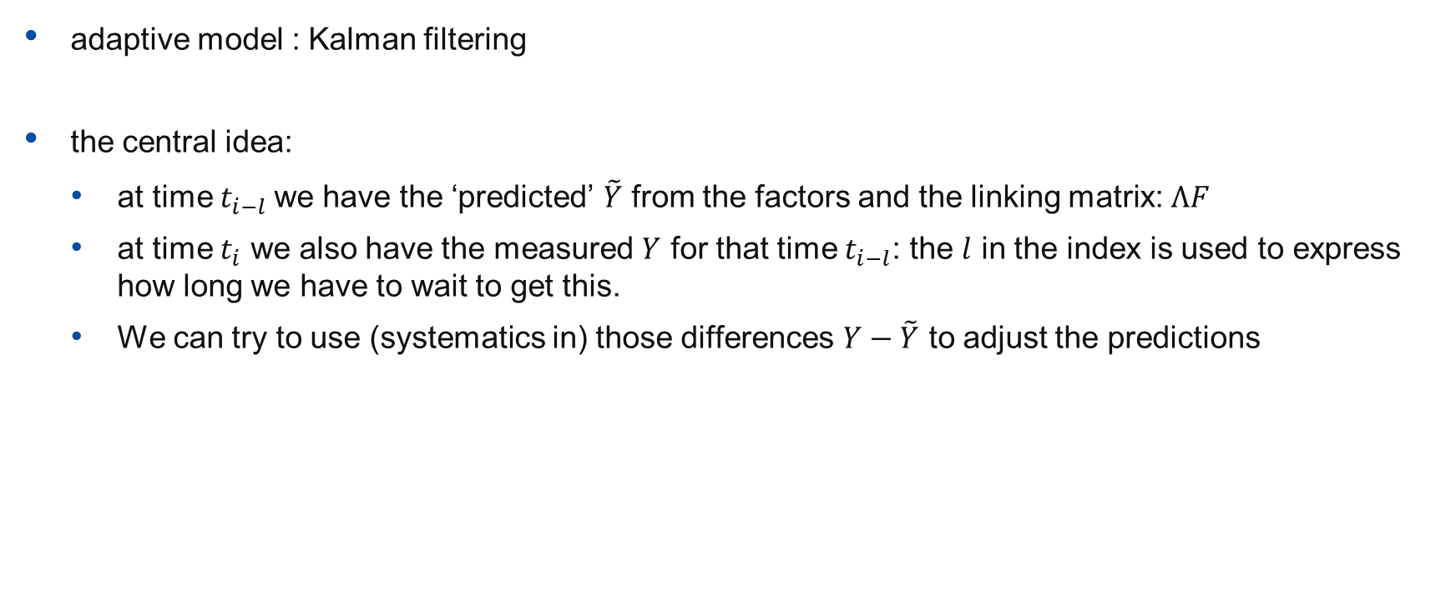
correction and control (I)
adaptive model : Kalman filtering
the central idea:
  at time$t_{i−l}$ we have the ‘predicted’ $\tilde{Y}$ from the factors and the linking matrix: $ΛF$
  at time $t_{i}$ we also have the measured $Y$ for that time $t_{i−l}$: the $l$ in the index is used to express how long we have to wait to get this.
  We can try to use (systematics in) those differences $Y−\tilde{Y}$ to adjust the predictions

Slide 24
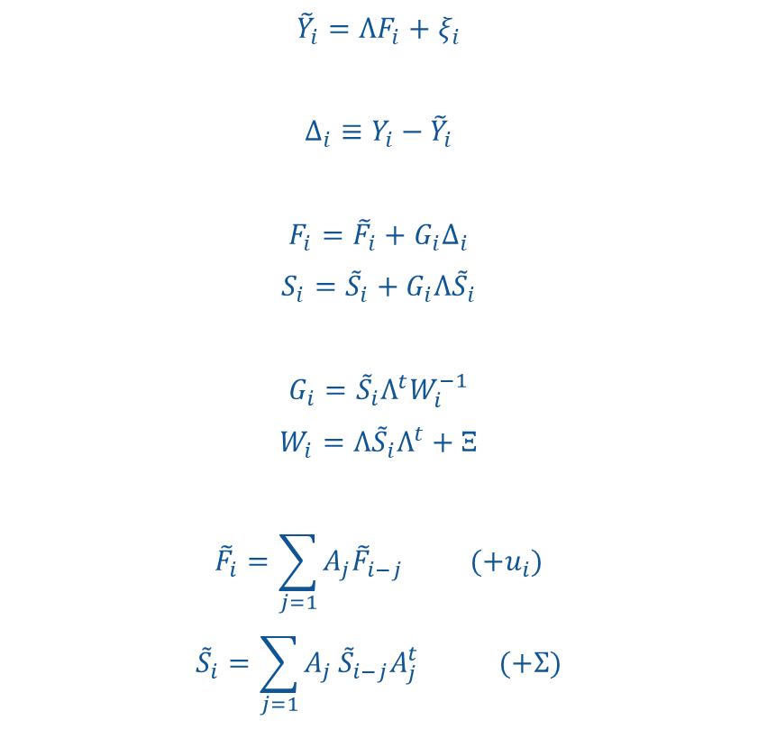
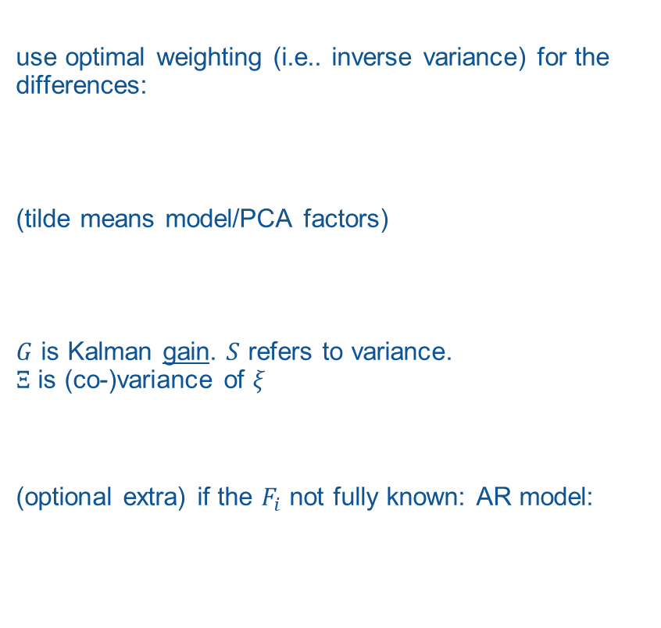
correction and control (II)
use optimal weighting (i.e.. inverse variance) for the differences:
(tilde means model/PCA factors)
$G$ is Kalman gain. $S$ refers to variance.
$Ξ$ is (co-)variance of $ξ$
(optional extra) if the $F_{i}$ not fully known: AR model:
$${\tilde{Y}}_{i}=ΛF_{i}+ξ_{i}$$
$$Δ_{i}≡Y_{i}−{\tilde{Y}}_{i}$$
$$F_{i}={\tilde{F}}_{i}+G_{i}Δ_{i}$$
$$S_{i}={\tilde{S}}_{i}+G_{i}{Λ\tilde{S}}_{i}$$
$$G_{i}={\tilde{S}}_{i}Λ^{t}W_{i}^{−1}$$
$$W_{i}=Λ{\tilde{S}}_{i}Λ^{t}+Ξ$$
$${\tilde{F}}_{i}=\sum_{j=1}{A_{j}{\tilde{F}}_{i−j} (+u_{i})}$$
$${\tilde{S}}_{i}=\sum_{j=1}{A_{j}}{\tilde{S}}_{i−j}A_{j}^{t} (+Σ)$$

Slide 25
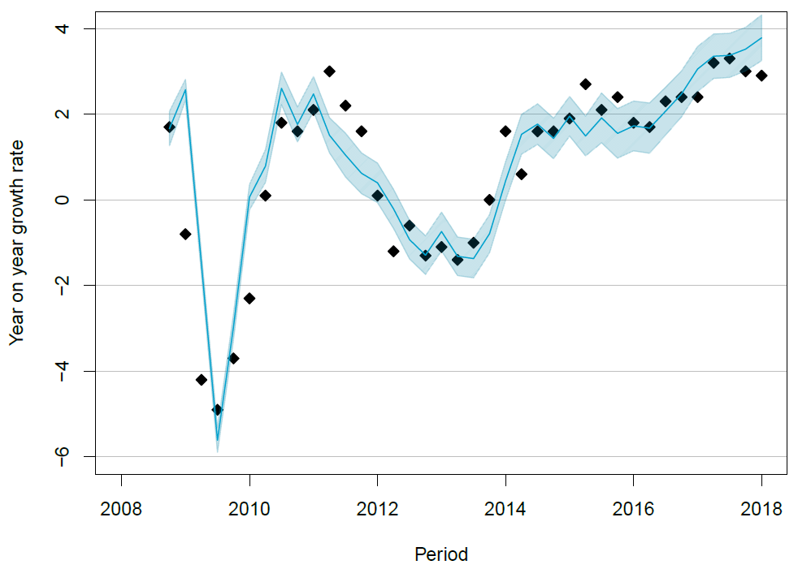

Slide 27
Missing data & ‘ragged edges’
‘flavours’ of missing data:
  random points in time series of explanatory variable
  systematic missings throughout : i.e. explanatory variables are mixed cadence or dependent has lower cadence than explanatory vars
  systematic missings at forward edge (ragged edge)

Slide 28
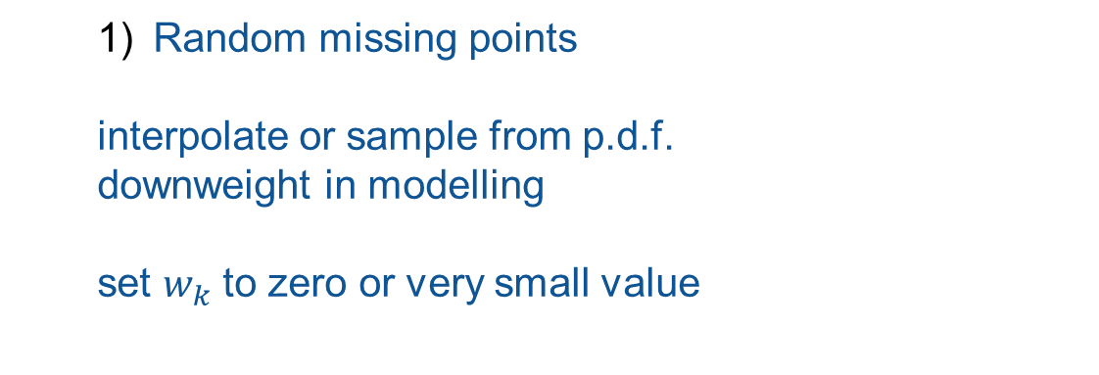
  Random missing points
  interpolate or sample from p.d.f.
  downweight in modelling
  set $w_{k}$ to zero or very small value

Slide 29
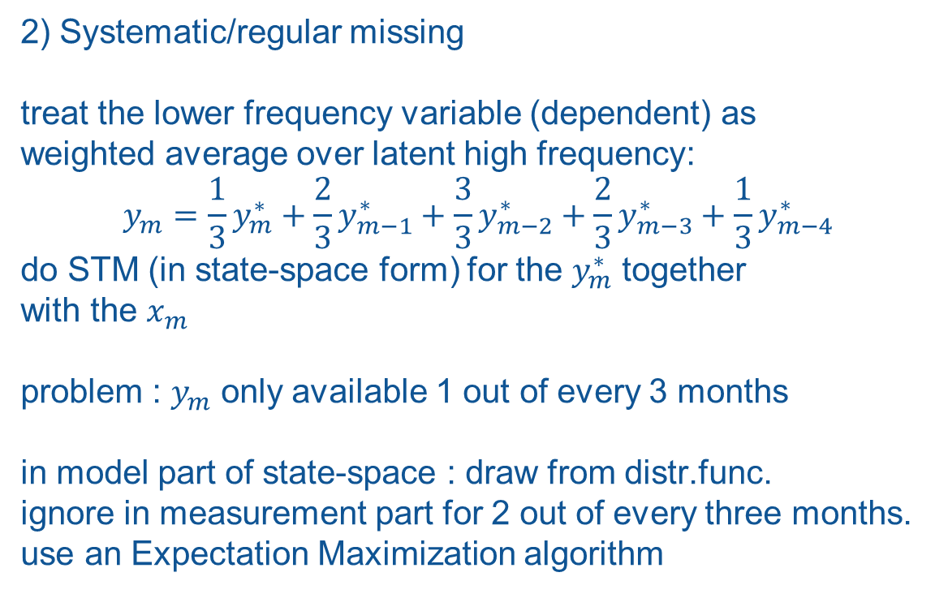
2) Systematic/regular missing
treat the lower frequency variable (dependent) as
weighted average over latent high frequency:
$$y_{m}=\frac{1}{3}y_{m}^{∗}+\frac{2}{3}y_{m−1}^{∗}+\frac{3}{3}y_{m−2}^{∗}+\frac{2}{3}y_{m−3}^{∗}+\frac{1}{3}y_{m−4}^{∗}$$
do STM (in state-space form) for the $y_{m}^{∗}$ together
with the $x_{m}$
problem : $y_{m}$ only available 1 out of every 3 months
in model part of state-space : draw from distr.func.
ignore in measurement part for 2 out of every three months.
use an Expectation Maximization algorithm

Slide 30
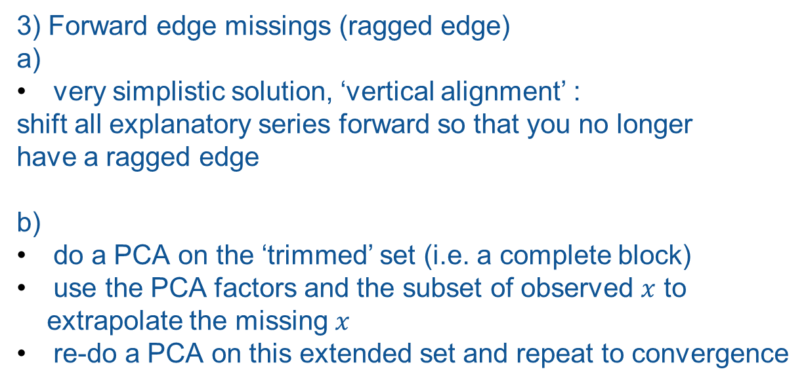
3) Forward edge missings (ragged edge)
a)
very simplistic solution, ‘vertical alignment’ :
shift all explanatory series forward so that you no longer
have a ragged edge
b)
do a PCA on the ‘trimmed’ set (i.e. a complete block)
use the PCA factors and the subset of observed $x$ to
extrapolate the missing $x$
re-do a PCA on this extended set and repeat to convergence

Slide 31
further extensions
asymmetric filters : weight differences between upward and downward updates/estimates
(i.e. positively directed or negatively directed changes due to any particular regressor
non-linear models
regime changes (e.g. re-basing of indicators)
separation by frequency-bands of signals
(trend, cycle, seasonal)

Slide 32
Exercise
The training material includes the .csv file “85692NED_TabelIndeling_20260817115615.csv”
This is a time series of CBS open data, at monthly cadence from Jan 2013 to May 2026, on the number of persons receiving a certain type of unemployment benefit
In R there is a package “forecast” (Hyndman, Khandakar) which you can apply to this time series.
  try some variants of ARIMA models implemented in the package. What parameters seem best?
  does inclusion of seasonal effects make a difference?
  What would you conclude concerning a stochastic component or noise? How does this influence the margin of uncertainty on your forecast?

Slide 33
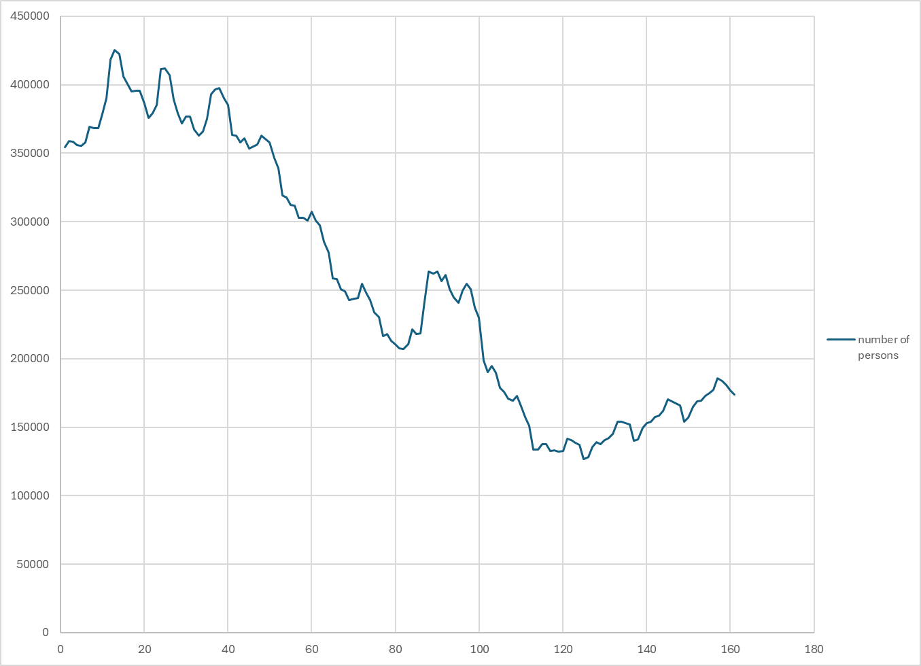

Slide 34
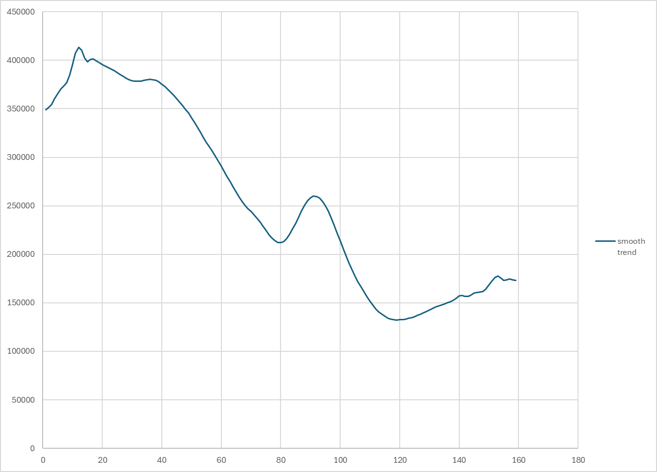

Slide 35
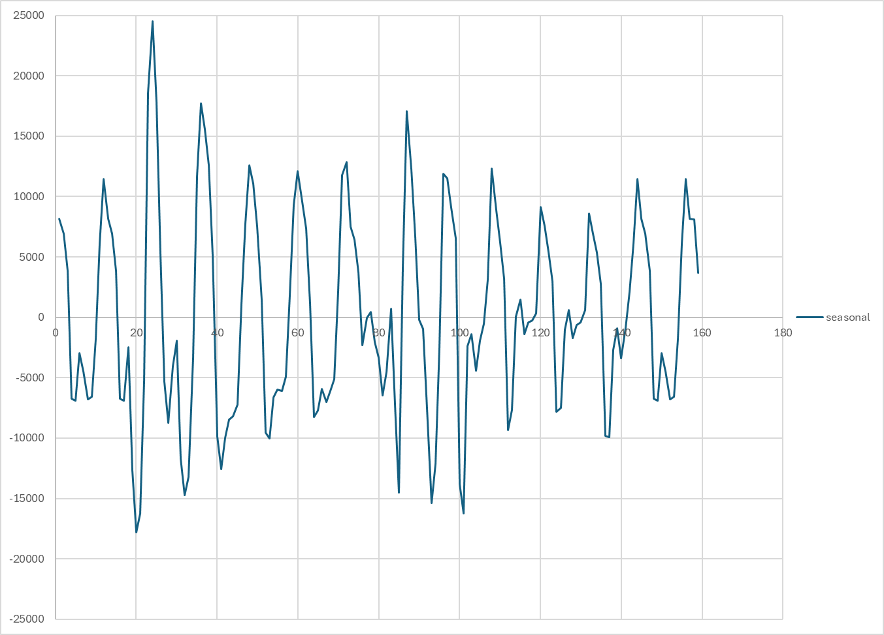

Slide 36
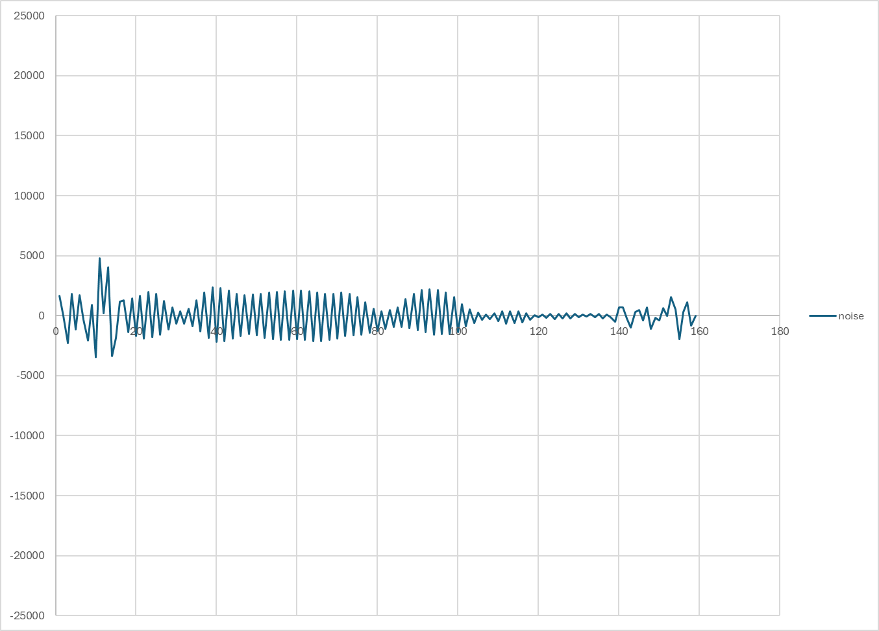
raw
smooth trend
seasonal
stochastic

Slide 37
Further questions ?

